Slide 1

Quantitative vs Qualitative information regarding
fragmentation
NAME – ABHIRUP BAG ROLL – 13000122082 DEPARTMENT – CSE(B) SEMESTER – 6 PAPER – Distributed Database Management System(PEC-IT 601B)

Slide 2

content
Introduction
Quantitative vs Qualitative Information
Quantitative information
Qualitative information
Comparison with Parameters
Practical Application
Example scenario
Conclusion
References
3
4
5 - 7
8 - 10
11
12
13-15
16
17

Slide 3
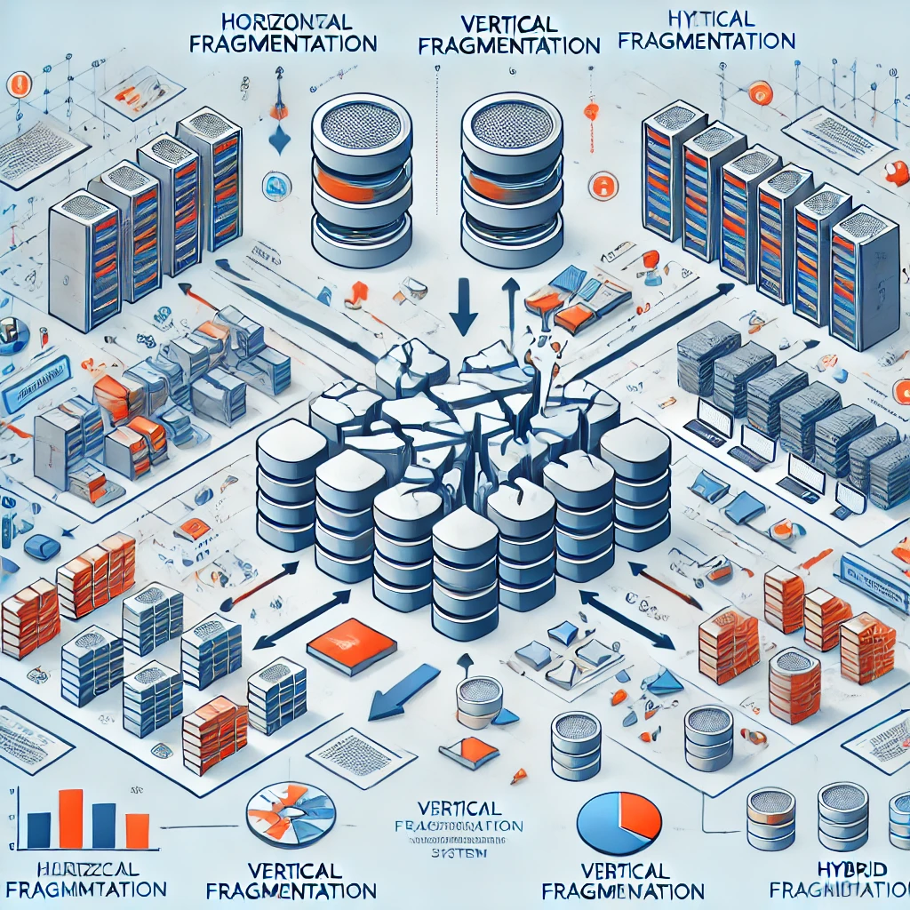
INTRODUCTION
What is Fragmentation in Distributed DBMS?
Division of a database into smaller parts (fragments) stored across multiple nodes.
Why is Fragmentation Important?
Improves performance, scalability, and resource utilization.
Objective of the Presentation:
Understand the role of quantitative and qualitative information in fragmentation.
Explore key parameters: minterm selectivity, access frequency, completeness, and minimality.

Slide 4

Quantitative vs Qualitative Information
1
Quantitative Information:
Numerical, measurable data.
Focus: Performance metrics, statistics.
Examples: Minterm selectivity, access frequency.
2
Qualitative Information:
Descriptive, conceptual data.
Focus: Design principles, trade-offs.
Examples: Completeness, minimality.

Slide 5
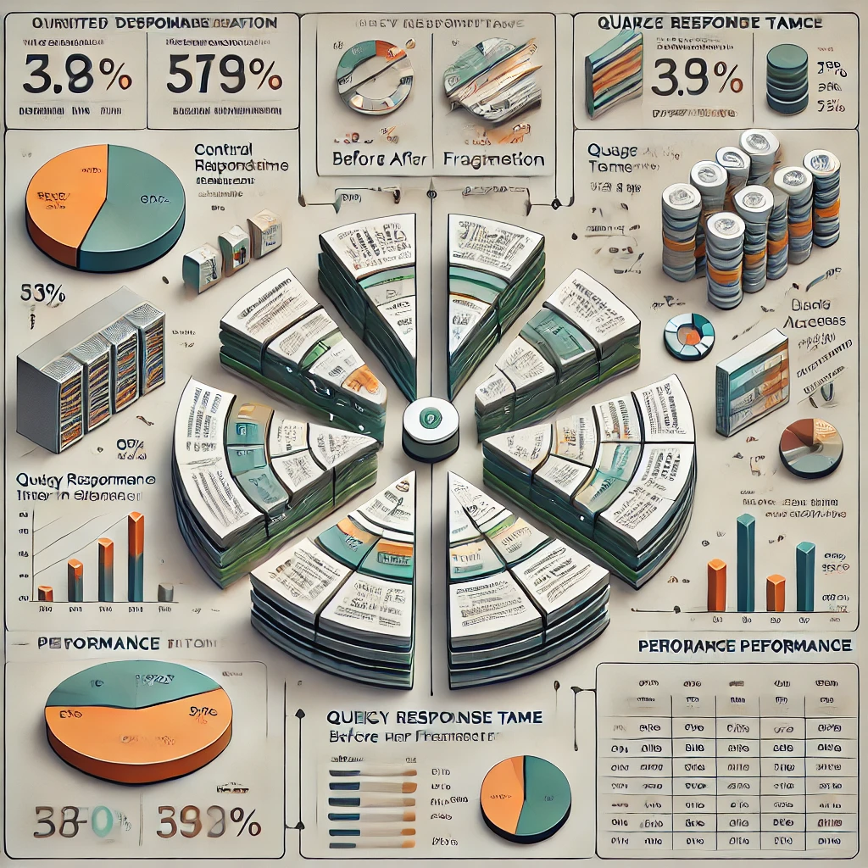
Quantitative information
Quantitative analysis of fragmentation in a Distributed DBMS helps evaluate efficiency and performance. Key metrics include:
Fragmentation Granularity (FG): Measures fragment size in terms of rows or columns.
Data Transmission Cost (DTC): Cost of transferring fragments across network nodes.
Access Frequency (AF): Number of times a fragment is accessed, influencing placement decisions.
Response Time (RT): Time taken to execute queries involving fragmented data.
Redundancy Ratio (RR): Measures data duplication in replicated fragments.
Fragmentation Completeness (FC): Ensures all necessary data is included in fragments.
Fragmentation Disjointness (FD): Ensures minimal data duplication (except for replication).
Efficient fragmentation minimizes data transfer costs, improves query performance, and enhances system scalability.

Slide 6

Minterm Selectivity:
Definition: Minterm selectivity refers to the probability of a record satisfying a given minterm predicate in a horizontal fragmentation scheme.
Measurement: Represented as a fraction (0 to 1) or a percentage (0% to 100%).
Usage: Helps in optimizing horizontal fragmentation by ensuring balanced partitioning based on frequently used predicates.
Example: If a minterm predicate is Region = 'North', selectivity quantifies how many rows match this condition.

Slide 7
Access Frequency:
Definition: The number of times a fragment is accessed over a given period.
Measurement: Expressed as requests per second (RPS), queries per minute (QPM), or other time-based metrics.
Usage: Determines optimal fragment placement to minimize network latency and data transfer costs.
Example: A fragment containing customer data for a specific region may be accessed 1,000 times per day.

Slide 8
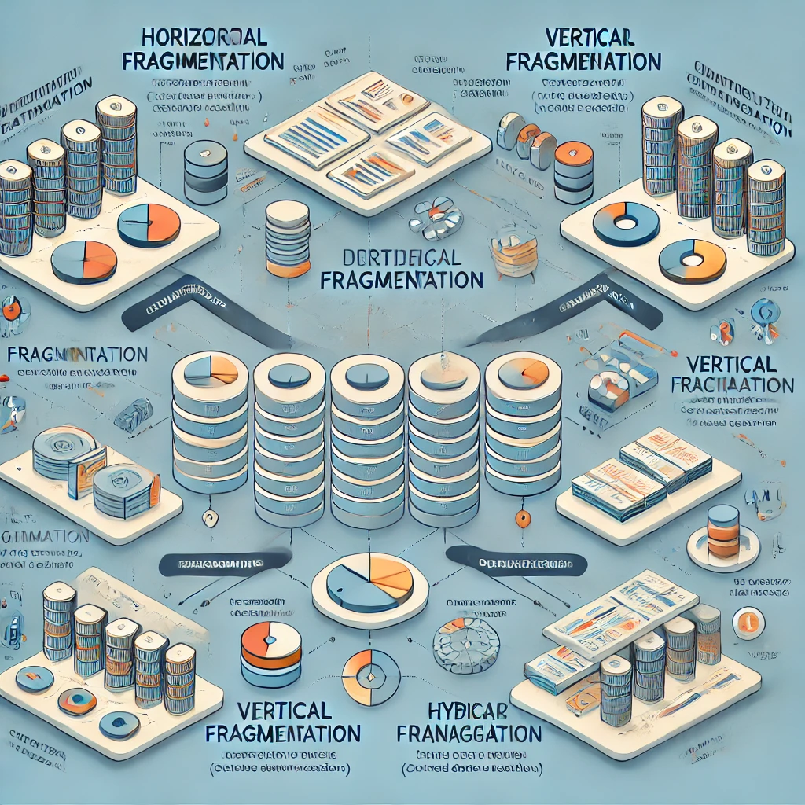
Qualitative information
Qualitative aspects of fragmentation in a Distributed DBMS focus on the logical and structural effectiveness of data distribution. Key considerations include:
Data Locality: Ensures frequently accessed data is placed close to users to improve performance.
Scalability: Supports system growth by enabling efficient distribution of data across multiple sites.
Reliability & Availability: Proper fragmentation enhances fault tolerance and ensures data availability.
Consistency: Maintains data integrity by minimizing redundancy and synchronization issues.
Query Optimization: Well-designed fragmentation reduces query processing time by eliminating irrelevant data retrieval.
A well-planned fragmentation strategy enhances system efficiency, reliability, and user experience in distributed databases.

Slide 9
Completeness Parameter
Definition: Ensures that when a relation is fragmented, no data is lost—i.e., the union of all fragments reconstructs the original relation.
Qualitative value: A design principle that ensures no data loss during fragmentation.
Usage:
Guarantees that fragmentation does not exclude any tuples.
Affects query correctness and data integrity.
Example: A fragmentation strategy must ensure that all customer records are preserved across fragments, even if they are distributed geographically.

Slide 10
Minimality Parameter
Definition: Ensures that no redundant data exists across fragments unless explicitly required (e.g., replication).
Usage:
Prevents unnecessary data duplication across sites.
Helps in storage efficiency and reducing synchronization costs.
Qualitative value: A design principle that avoids over-fragmentation or redundancy.
Example: A fragmentation strategy should avoid creating too many small fragments, as this increases management overhead.

Slide 11
Comparison with Parameters
Parameter | Quantitative Information | Qualitative Information
Minterm Selectivity | Proportion of tuples satisfying a predicate (e.g., 30%). | N/A (Quantitative only).
Access Frequency | Number of accesses per fragment (e.g., 1,000/day). | N/A (Quantitative only).
Completeness | N/A (Qualitative only). | Ensures no data loss during fragmentation.
Minimality | N/A (Qualitative only). | Avoids unnecessary complexity or redundancy.

Slide 12
Practical Application
1
Quantitative Analysis:
Use minterm selectivity to identify frequently accessed data subsets and optimize query performance.
Use access frequency to allocate resources (e.g., placing high-traffic fragments on high-performance nodes).
2
Qualitative Analysis:
Use completeness to ensure data integrity and compliance with business or regulatory requirements.
Use minimality to design a fragmentation strategy that is efficient and scalable.

Slide 13
Example scenario
Consider a distributed DBMS for a organisation with database schema:
PAY(TITLE, SAL)
EMP(ENO, ENAME, TITLE)
PAY(TITLE, SAL) TABLE :
TITLE | SAL
MANAGER | 65K
ELECTRICAL ENGINEER | 52K
PREGRAMMER | 45K
ACCOUNTANT | 42K
}
}
PAY-1
PAY-2

Slide 14
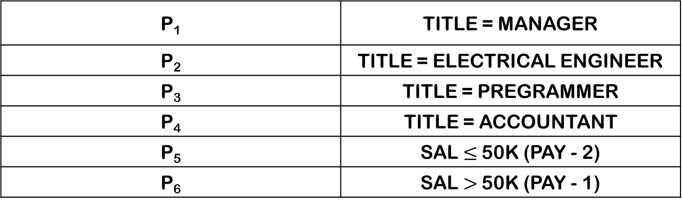
Simple Predicate
Some Minterm Predicates And Minterm Selectivity [Sel(M_{i})]
P₁ | TITLE = MANAGER
P₂ | TITLE = ELECTRICAL ENGINEER
P₃ | TITLE = PREGRAMMER
P₄ | TITLE = ACCOUNTANT
P₅ | SAL $≤$50K (PAY - 2)
P₆ | SAL $>$50K (PAY - 1)
M_{i} | Minterm Predicate | Sel(M_{i})
M₁ | P₁ ^ P₂ | 0
M₂ | P₁ ^ P₆ | 1
M₃ | P₃ ^ P₆ | 1
M₄ | P₄ ^ P₆ | 0

Slide 15
Access frequency:
The Sal > 50K is accessed 50 times per day.
Qualitative Information:
Completeness: All order records are preserved across fragments, ensuring no data loss.
Minimality: The fragmentation strategy avoids creating too many small fragments, reducing management overhead.

Slide 16
Conclusion
Effective fragmentation in a Distributed DBMS requires both quantitative and qualitative considerations. Minterm selectivity and access frequency help optimize performance, while completeness and minimality ensure data integrity and efficiency. Balancing these factors leads to better query performance, reduced redundancy, and improved scalability in distributed databases.

Slide 17
REFERENCES
📘 "Distributed Databases: Principles & Systems" – Stefano Ceri, Giuseppe Pelagatti
📗 "Principles of Distributed Database Systems" – M. Tamer Özsu, Patrick Valduriez
📕 "Fundamentals of Database Systems" – Ramez Elmasri, Shamkant B. Navathe
📙 "Distributed Database Management Systems: A Practical Approach" – Saeed K. Rahimi, Frank S. Haug
📔 "Database System Concepts" – Abraham Silberschatz, Henry F. Korth, S. Sudarshan

Slide 18

